Slide 1


Employee Retention Analysis
Domain - Hr. Analytics
Project Name – Human Retention
Group - 3
Team Members - 4
Tiny Ajesh
Muhammed Musthafa
Nalipireddy Aparna
Pranoti Tanajirao Desai
Uncovering the key drivers of attrition and building actionable strategies to retain valuable talent

Slide 2

Project Objective
To analyze the key reasons for employee attrition and identify actionable insights that help the HR department retain valuable employees. The analysis focuses on salary, promotions, work-life balance, and department performance .
This data-driven approach enables HR to make informed decisions about retention strategies, compensation adjustments, and workplace improvements that directly impact employee satisfaction and organizational success.

Slide 3
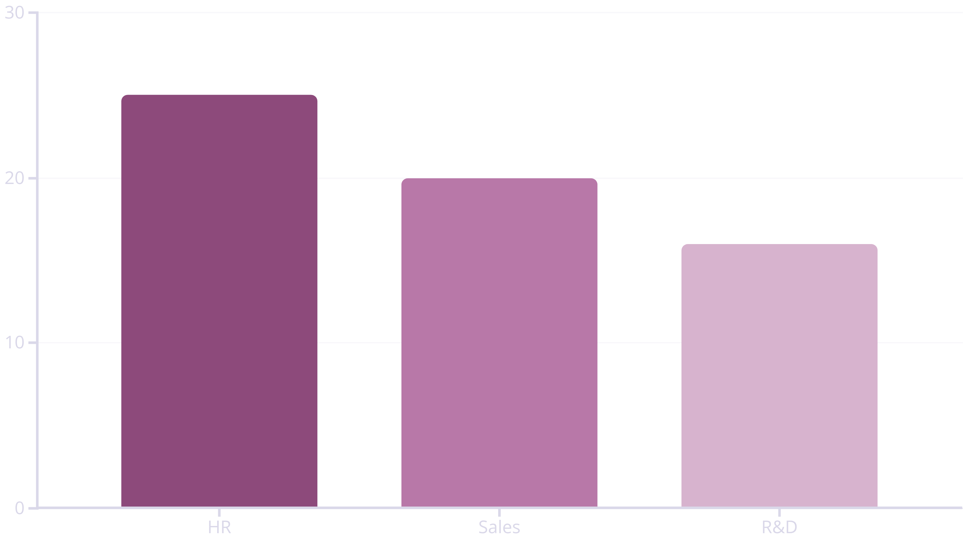

KPI (1.) Average Attrition Rate For All Department
Understanding which departments face the highest turnover challenges
HR shows the highest attrition at 25%, indicating employee dissatisfaction or limited career growth opportunities. R&D demonstrates better retention at 16% due to more stable work conditions and technical career paths. Sales falls in the middle at 20%, suggesting moderate retention challenges.
✅ Recommendation: HR and Sales departments should focus on employee engagement programs and targeted training initiatives to improve retention.
HR shows the highest attrition at 25%, indicating employee dissatisfaction or limited career growth opportunities. R&D demonstrates better retention at 16% due to more stable work conditions and technical career paths. Sales falls in the middle at 20%, suggesting moderate retention challenges.
✅ Recommendation: HR and Sales departments should focus on employee engagement programs and targeted training initiatives to improve retention.

Slide 4


KPI (2.) Average Hourly rate
Male Research Scientists
Average Hourly Rate: $35–$38/hour
The pay range for male research scientists is consistent with company averages, with no major pay gap observed. This indicates fair compensation practices within this role.
✅ Recommendation: Continue maintaining salary parity and introduce skill-based incentives to reward high performers.

Slide 5
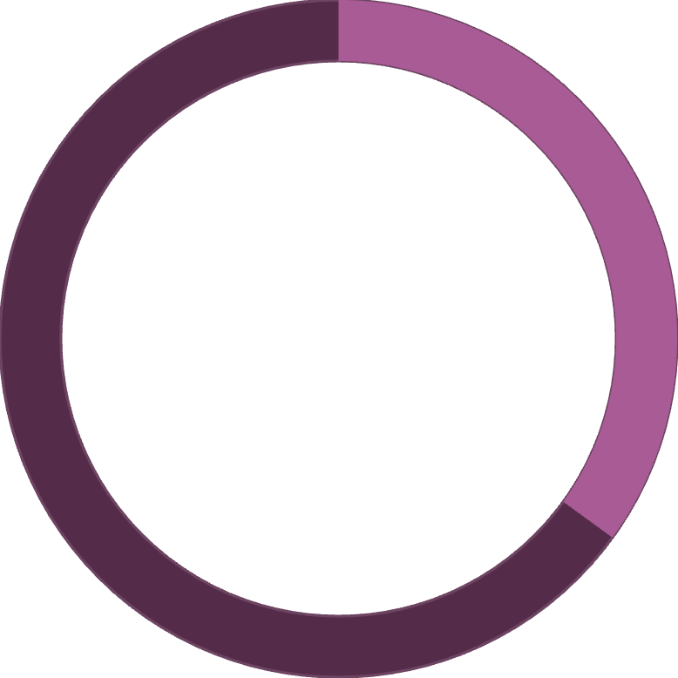
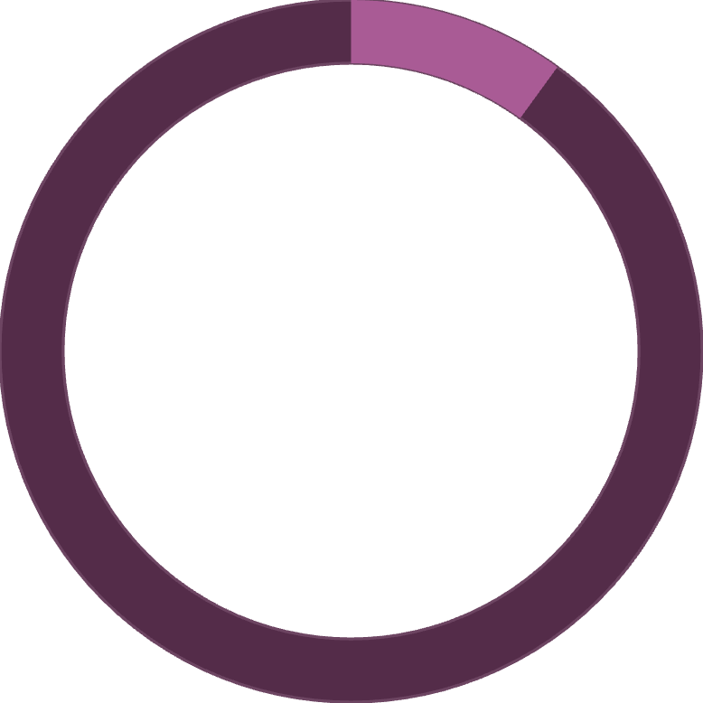

KPI (3.) Attrition Rate Vs Monthly Income Status
35%
10%
Low Income Attrition
High Income Attrition
Employees earning below $4,000/month
Employees earning above $8,000/month
A strong inverse relationship exists between income and attrition. Employees in lower salary ranges show significantly higher turnover rates (30%–35%), while those earning above $8,000 monthly demonstrate excellent retention with less than 10% attrition. This clear pattern indicates that compensation is a critical factor in employee retention decisions.
✅ Recommendation: Review salary structure and provide performance-based raises, especially for lower-income groups to reduce turnover.

Slide 6

KPI (4.) Average Working Years For Each Department
R&D Department
Sales Department
HR Department
9 years average tenure
6 years average tenure
5 years average tenure
Most stable workforce with technical career paths
Moderate stability with faster turnover
Shortest tenure indicating retention challenges
R&D employees demonstrate the highest stability at 9 years average tenure, possibly due to specialized technical career paths and project continuity. HR and Sales departments face faster turnover with 5-6 years average tenure, suggesting these roles may lack clear advancement opportunities or face higher workplace stress.
✅ Recommendation: Introduce long-term career planning and retention bonuses for Sales & HR staff to improve tenure.

Slide 7
KPI (5.) Job Role Vs WorkLife Balance
How different positions rate their work-life balance (Scale: 1–4)
87.5%
75%
62.5%
Managers
Lab Technicians & Research Scientists
Sales Executives
3.5 rating - Excellent balance
2.5 rating - Fair balance
3.0 rating - Good balance
Sales Executives report the poorest work-life balance at 2.5, likely due to performance pressure, client demands, and travel requirements. Managers enjoy the best balance at 3.5, while technical roles maintain good balance at 3.0.
✅ Recommendation: Offer flexible schedules or hybrid work options for sales teams to improve satisfaction and reduce burnout.

Slide 8
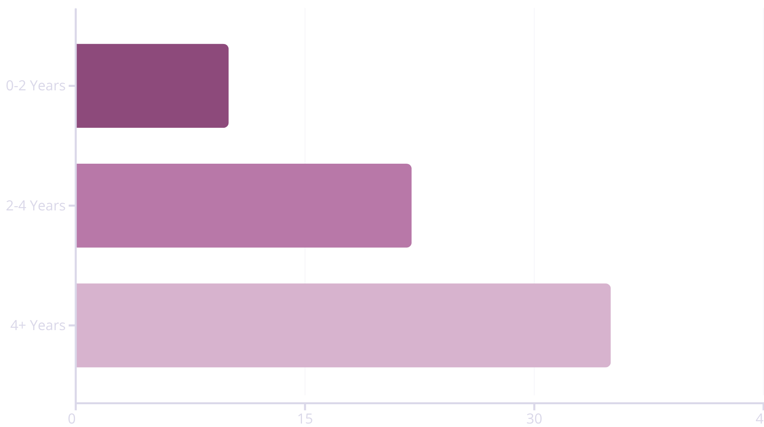

KPI (6.) Attrition Rate Vs Yearly Since Last Promotion
Employees with more than 4 years since their last promotion show dramatically high attrition at 35%. Those with recent promotions (under 2 years) demonstrate excellent retention at just 10%.
Lack of promotion is a key driver of employee turnover.
✅ Recommendation: Implement regular performance reviews and structured promotion cycles every 2–3 years to improve retention and career satisfaction.

Slide 9
Key Factors Impacting Retention
Salary
Promotion
Work-Life Balance
Department Focus
High impact: Strong attrition in lower income ranges. Revise pay scale and implement performance-based raises.
Critical factor: Strong link with retention. Introduce structured promotion paths every 2-3 years.
Moderate effect: Impacts satisfaction. Encourage flexible work arrangements and hybrid options.
Targeted approach: HR & Sales most affected. Focus engagement programs on high-risk departments.

Slide 10
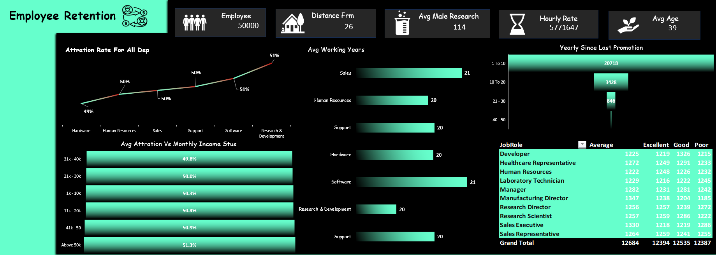
Excel - Dashboard

Slide 11
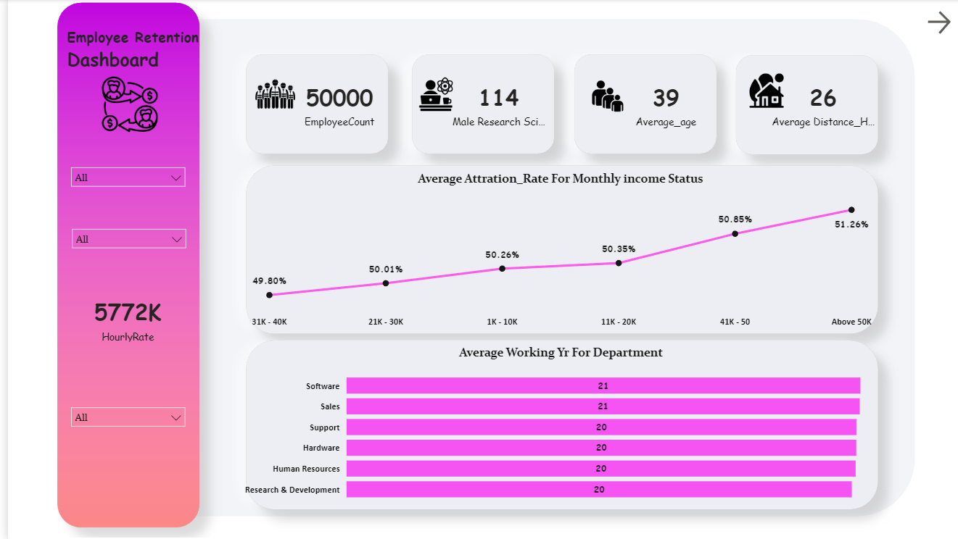
Power Bi - Dashboard – (1.)

Slide 12
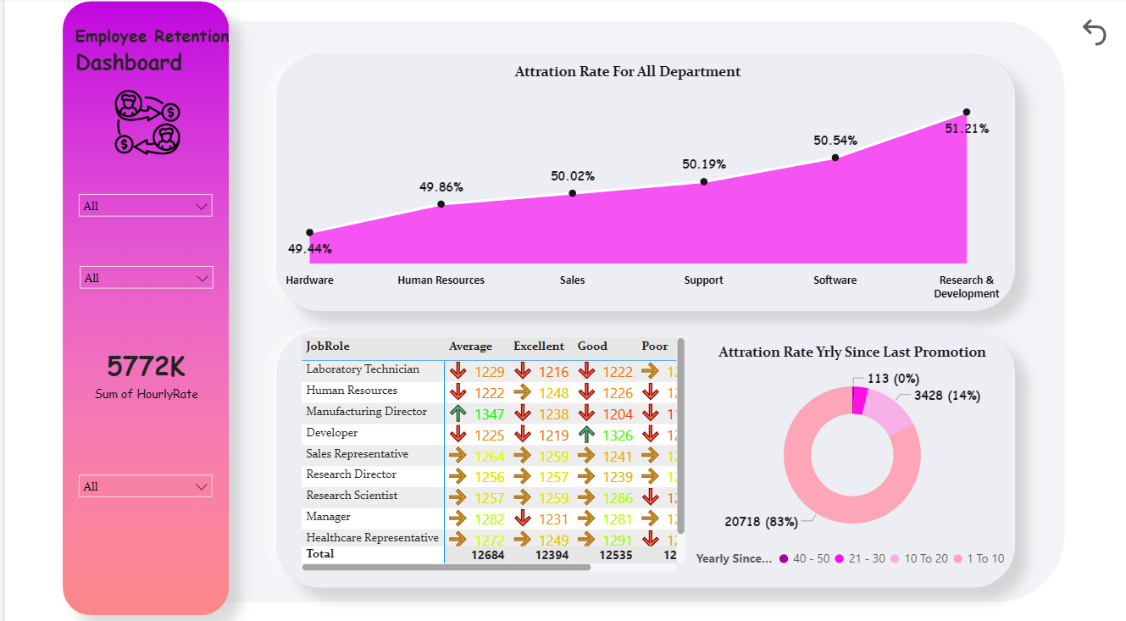
Power Bi - Dashboard – (2.)

Slide 13
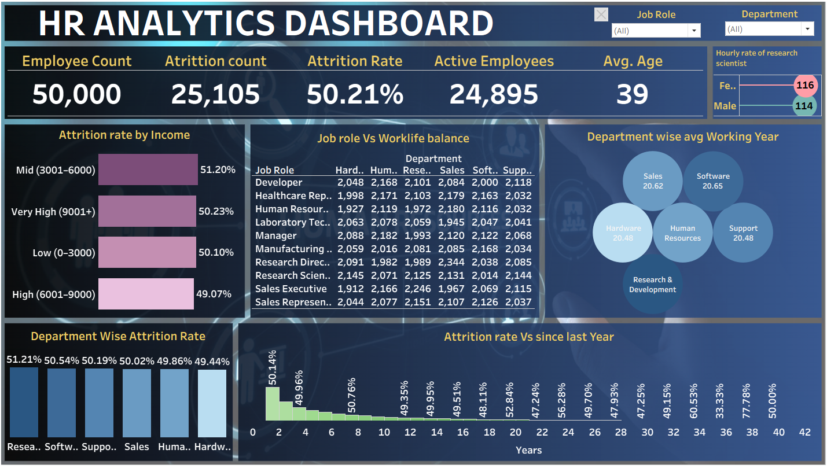
Tableau - Dashboard

Slide 14
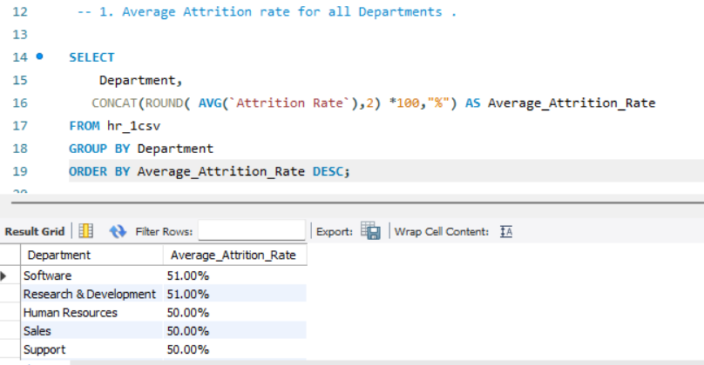
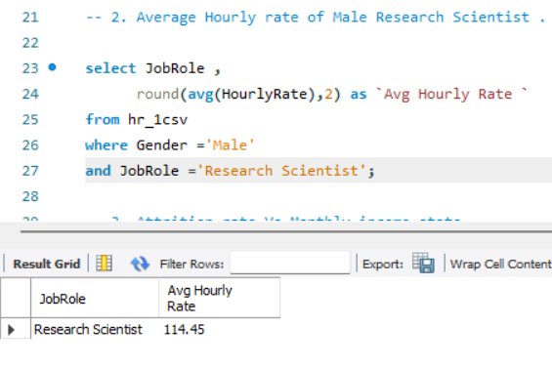
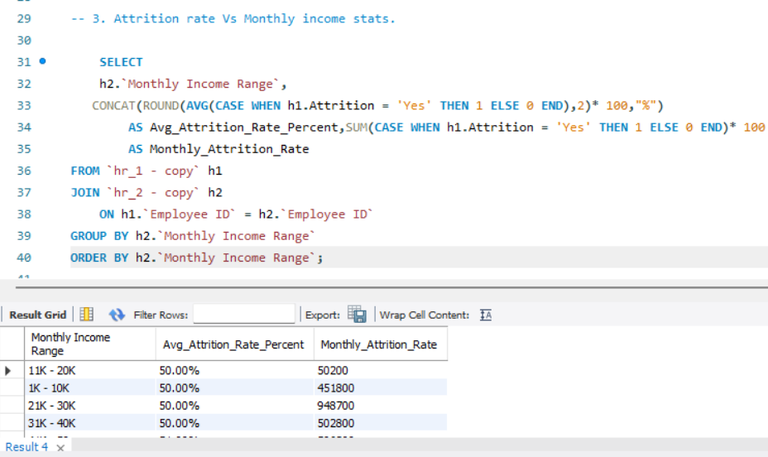
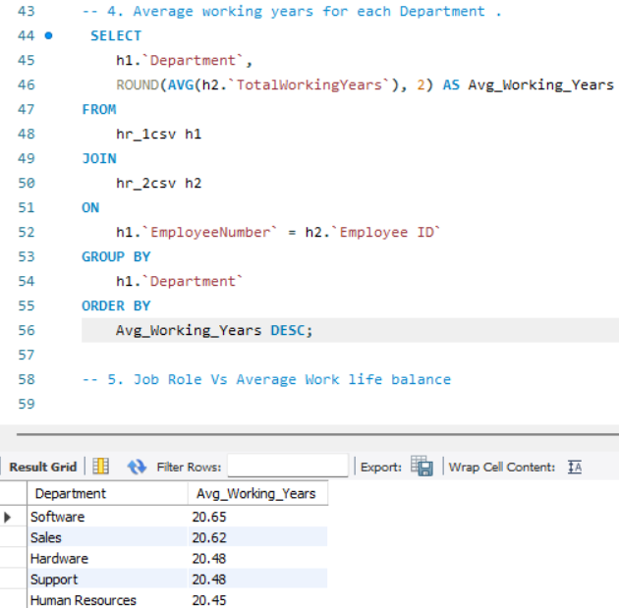
MySQL - Queries

Slide 15
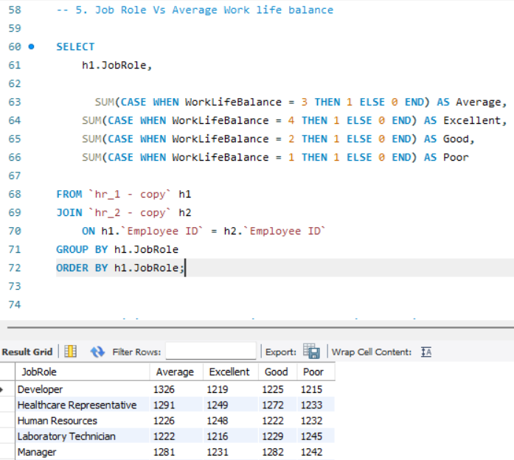
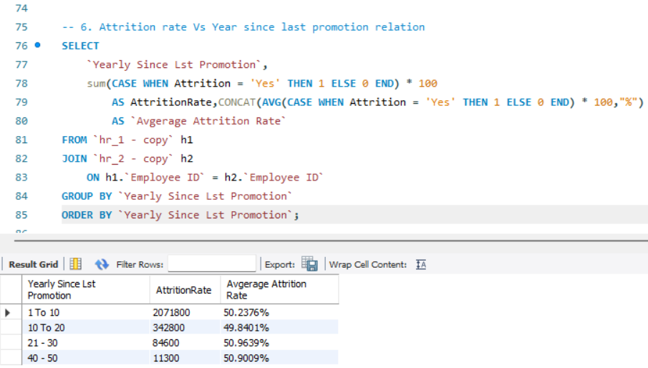
MySQL - Queries

Slide 16





Conclusion & Impact
Primary Drivers Identified
Strategic Focus Areas
Employee attrition is mainly influenced by compensation, promotion delays, and work-life balance
HR and Sales departments need focused retention strategies and engagement programs
Data-Driven Insights
Excel , Power bi , Tableau visualizations ,MySQL effectively revealed actionable insights for HR planning
This comprehensive analysis helps the organization identify at-risk employees and make data-driven decisions to improve retention and workplace satisfaction. By addressing compensation gaps, implementing structured promotion cycles, and improving work-life balance, the company can significantly reduce attrition and build a more engaged, loyal workforce.

